Slide 1

¿Quién eres tú?
Trimestre 2, Semana 1-2,
1a Clase

Slide 2
Los objetivos:
At the end of this lesson, students should be able to:
Identify and correctly use subject pronouns in Spanish
Conjugate the verb SER in the present tense.
Use the verb SER to introduce themselves and others.
Describe themselves and other using the verb SER along with appropriate forms of adjectives.
Ask and answer the question - ¿Quién eres tú?

Slide 3
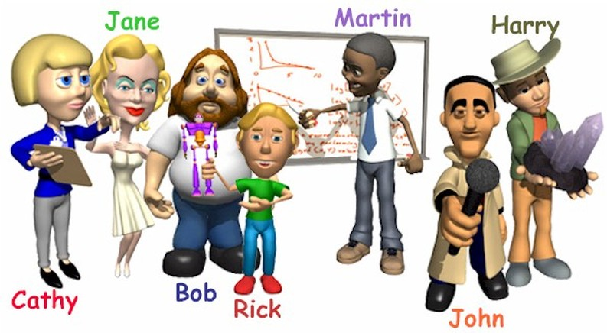
¿Quién eres tú?
You could answer this question by:
stating your name
Stating who you are in relation to someone else.
Notes:
Engagement 1: Have students discuss the meaning of the question ¿Quién eres? and what some possible responses to that question might be. The teacher will then reveal the meaning of the question.

Slide 4
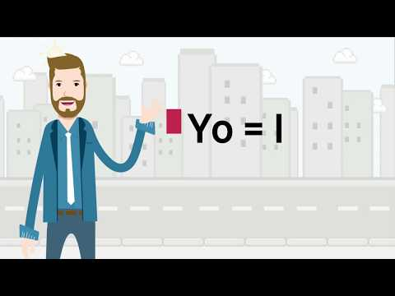
Notes:
Engagement 2: Students watch the music video above and are introduced to Spanish subject pronouns and their equivalents in English. It is highlighted that vosotros is used mainly in Spain

Slide 5
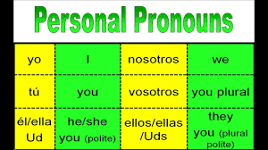

Slide 6
Actividad de clase
Replace the following names with the appropriate Personal Pronouns
Señorita Polson es una mujer.
Miranda y Pablo son hermanos.
Jorge y su hermano son mis primos.
You (plural) son buenas estudiantes.
Mi mamá y yo somos energéticas.
Notes:
The students are to complete this activity in class. They will not need to translate the sentences as yet. The idea is that they understand the concept of the pronouns.

Slide 7
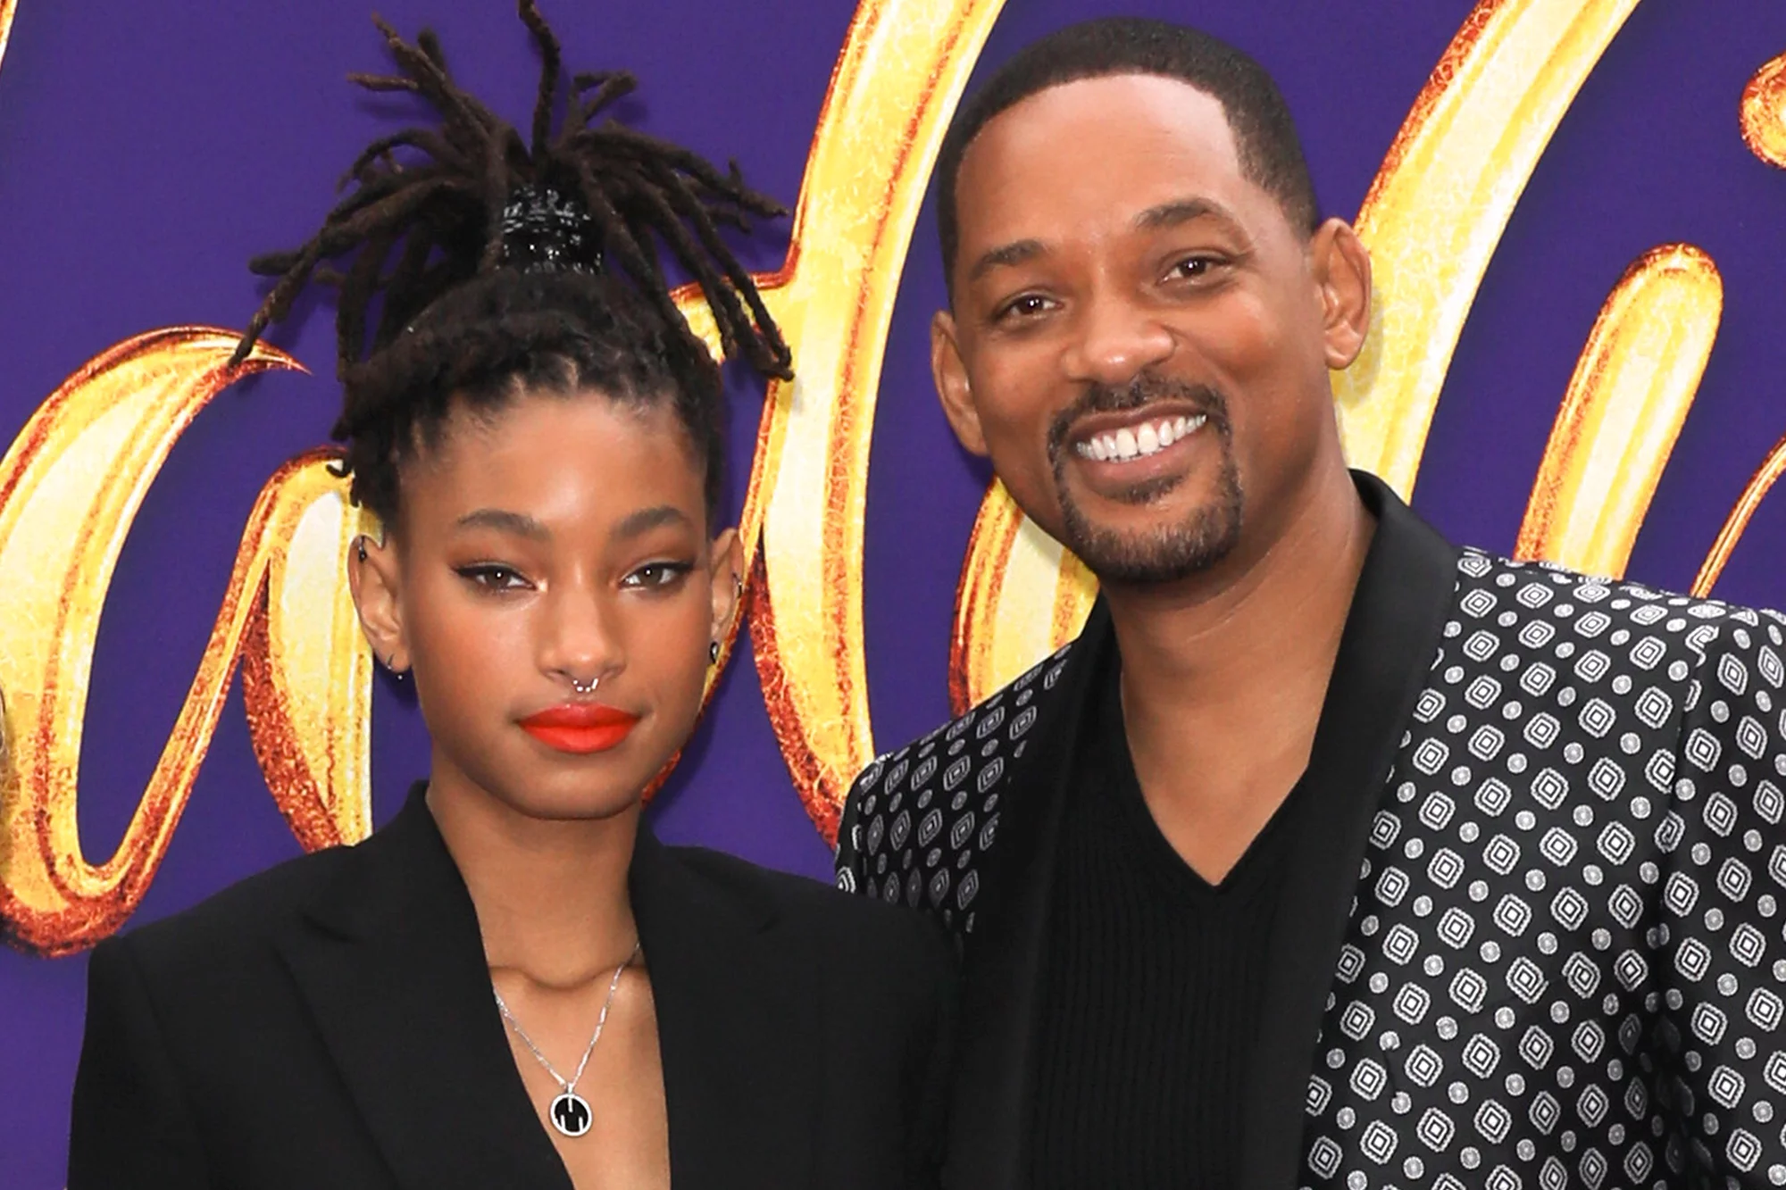
¿Quién eres tú?
2da CLASE
Yo soy Willow. Soy una mujer. Soy la hija de Will Smith.
Yo soy Will Smith. Soy un hombre. Soy el padre de Willow.
¿Quién es Will Smith?
¿Quién es Willow?
Notes:
Elaboration: Students see the verb SER and its various forms being used in context and are required to indicate understanding of a short snippet of text using such. Through this activity, they apply their knowledge with regards to the verb SER and the interrogative pronoun Quién, and are able to link the newly-acquired grammatical concept to real-life situations (introductions and descriptions of oneself and others).

Slide 8
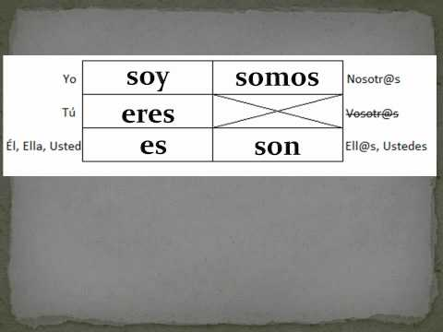
Notes:
Exploration: Students watch the video: https://youtu.be/w6TjefGxfPY . Then they should:
state what the verb SER means
fill out the table on the following slide with the correct forms of the verb ser corresponding to each subject pronoun.

Slide 9
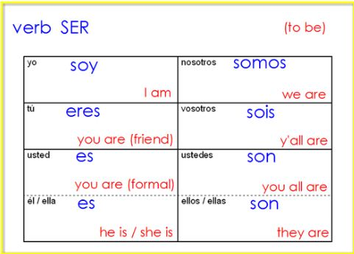
Notes:
Explanation:
Teacher explains the similarities of the verb “to be” in English to the verb “ser” in Spanish, with regards to its various forms in the present tense. S/he explains that just as how one cannot say “She be” and “You be”, one cannot say “Ella ser” or “Usted ser”. The verb must be changed to match the subject.
Students state what each form of the verb would translate to: “Yo soy” → “I am”

Slide 10
What we just did is called ✨Conjugation✨
Conjugation is the process by which the verb “shape shifts” according to the subject.
It's about tweaking the verb forms to match who is performing the action.

Slide 11

¿Quién eres tú?
Notes:
Elaboration: Allow 3 to 5 students to respond orally to the question, stating their name and their gender or relationship to a family member.

Slide 12
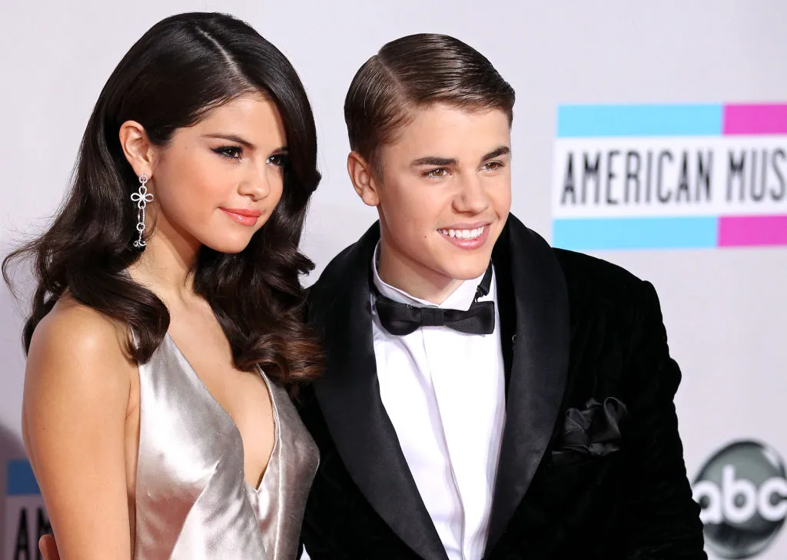
¿Quién es él/ella?
Fill in the blanks with the appropriate form of the verb SER.
Ellos ___ Justin y Selena.
Ella __ Selena Gómez.
__ una chica.
Él __ Justin Bieber.
__ un chico.
Note that I didn’t use the subject pronoun in the second sentence!
Notes:
Elaboration: Students demonstrate their ability to apply what they have learned by filling in the blanks to the slides above.

Slide 13
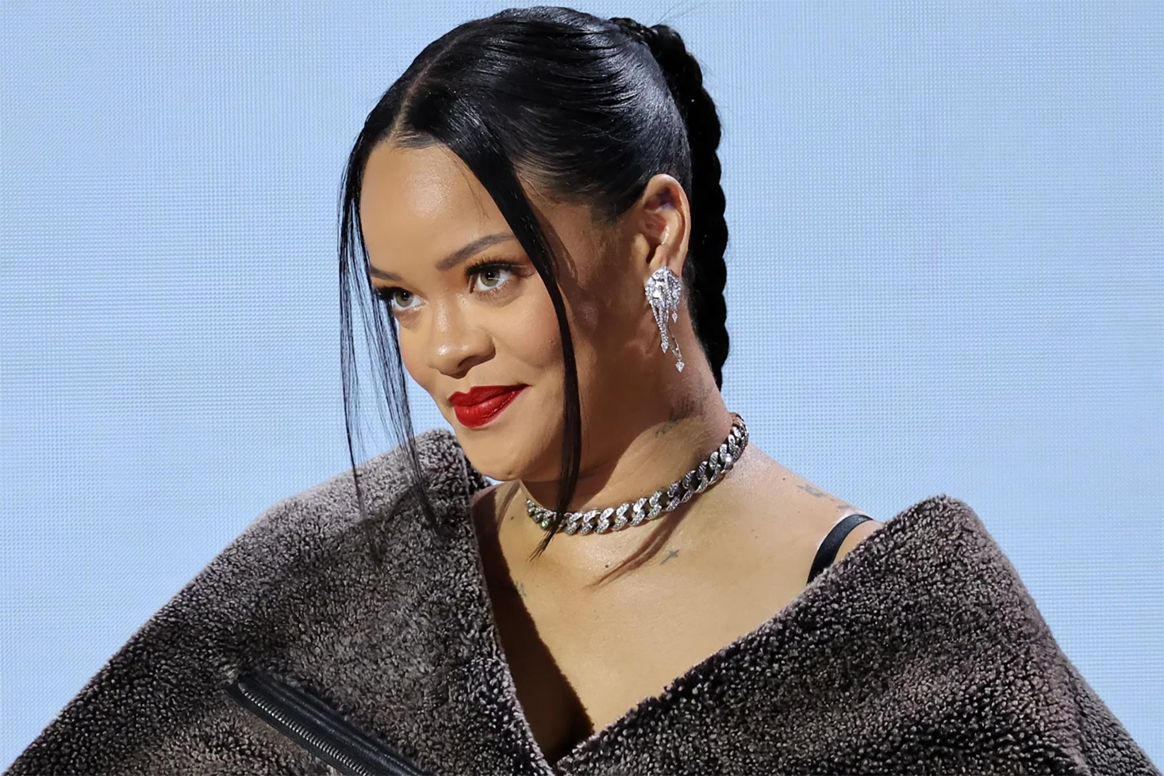
¿Quién es ella?
Notes:
Rihanna Fenty

Slide 14
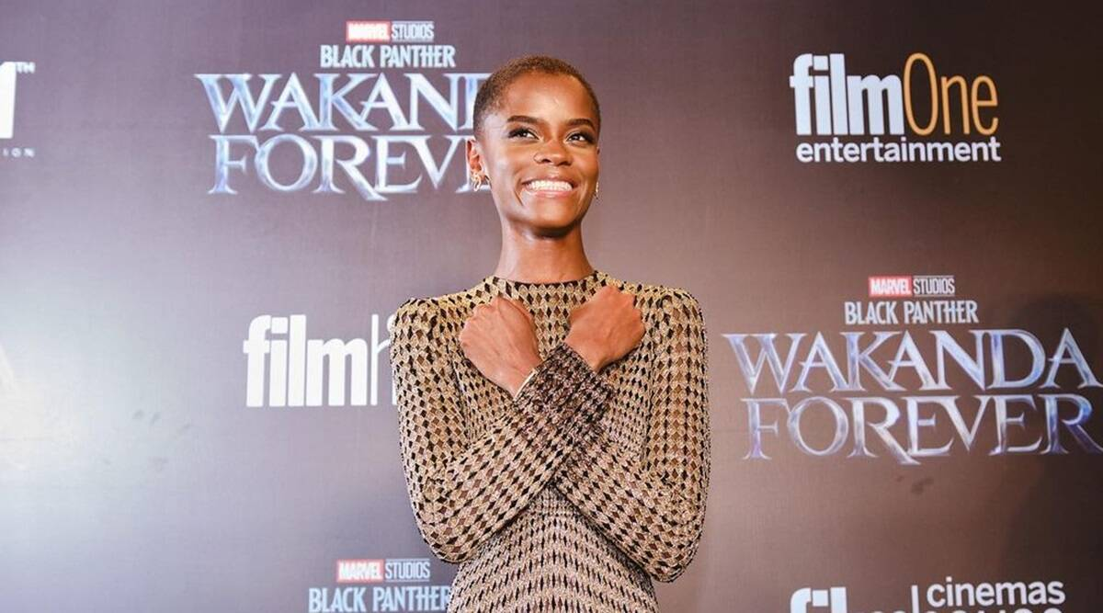
¿Quién es ella?
Notes:
Letitia Wright

Slide 15
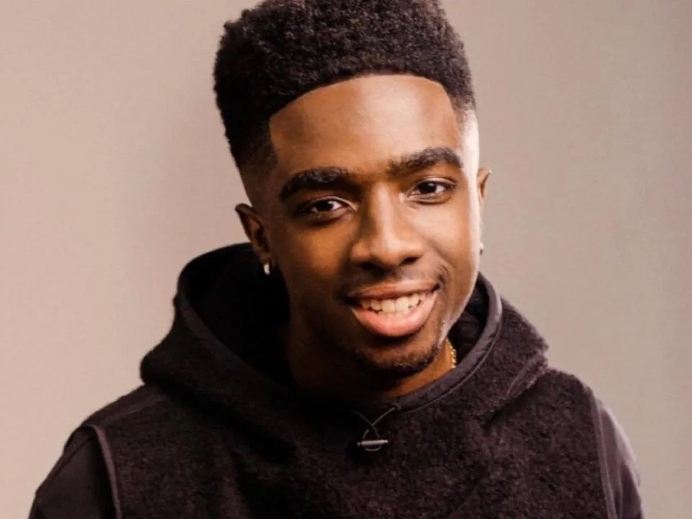
¿Quién es él?
Notes:
Caleb

Slide 16
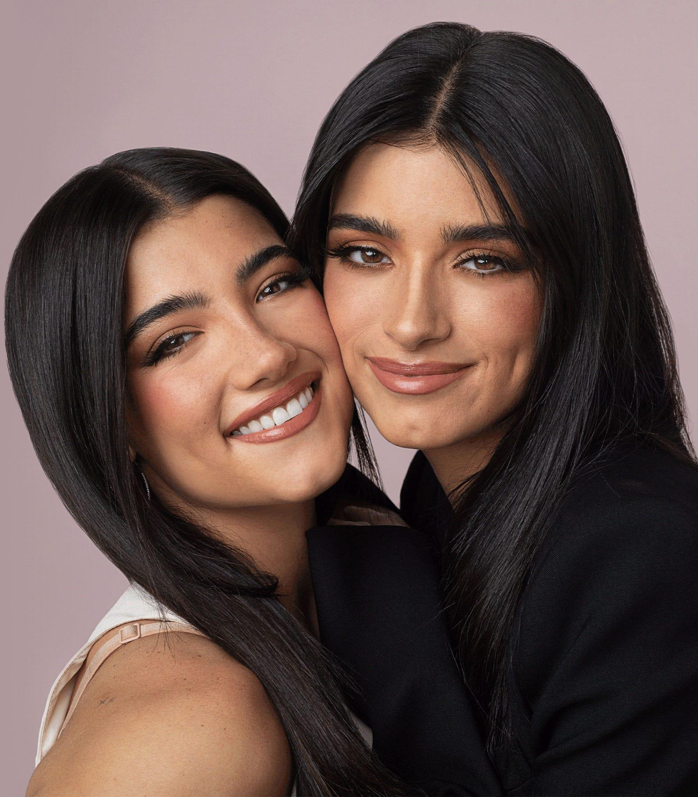
¿Quiénes son ellas?
Why did the word change to Quiénes?
Notes:
Charlie and Dixie D’amelio

Slide 17
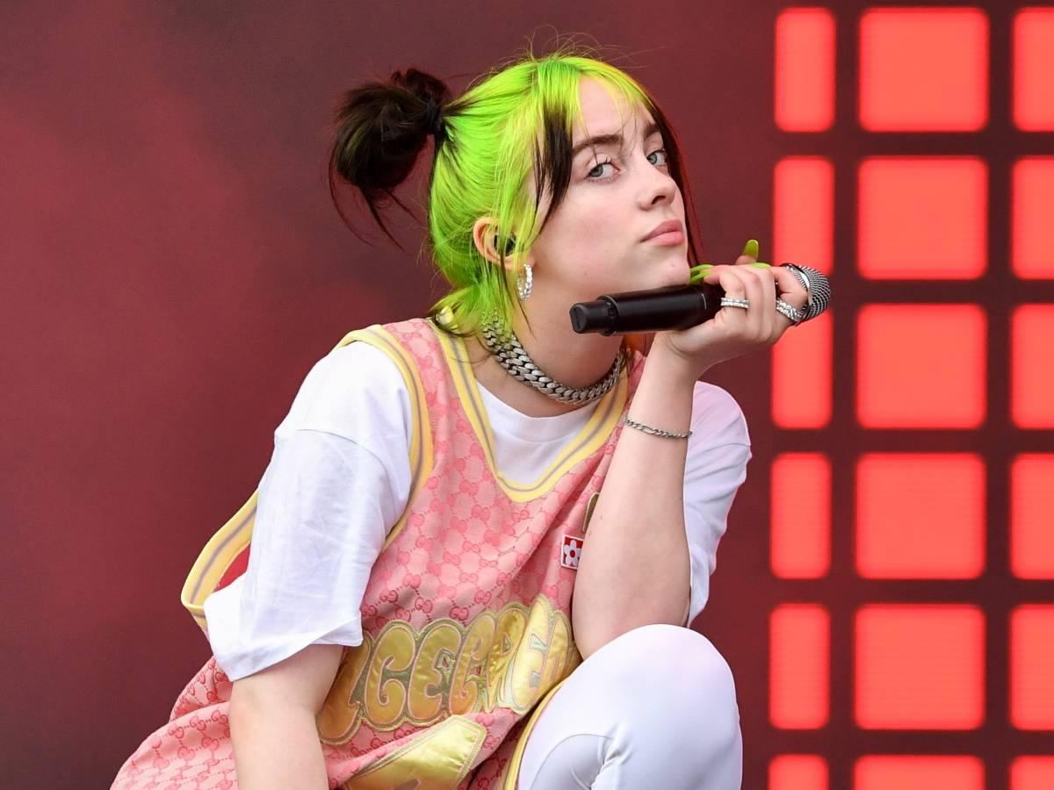
¿____________ ___ _____________?
Notes:
Billie Eilish

Slide 18

¿____________ ___ _____________?
Notes:
Stray Kidz

Slide 19
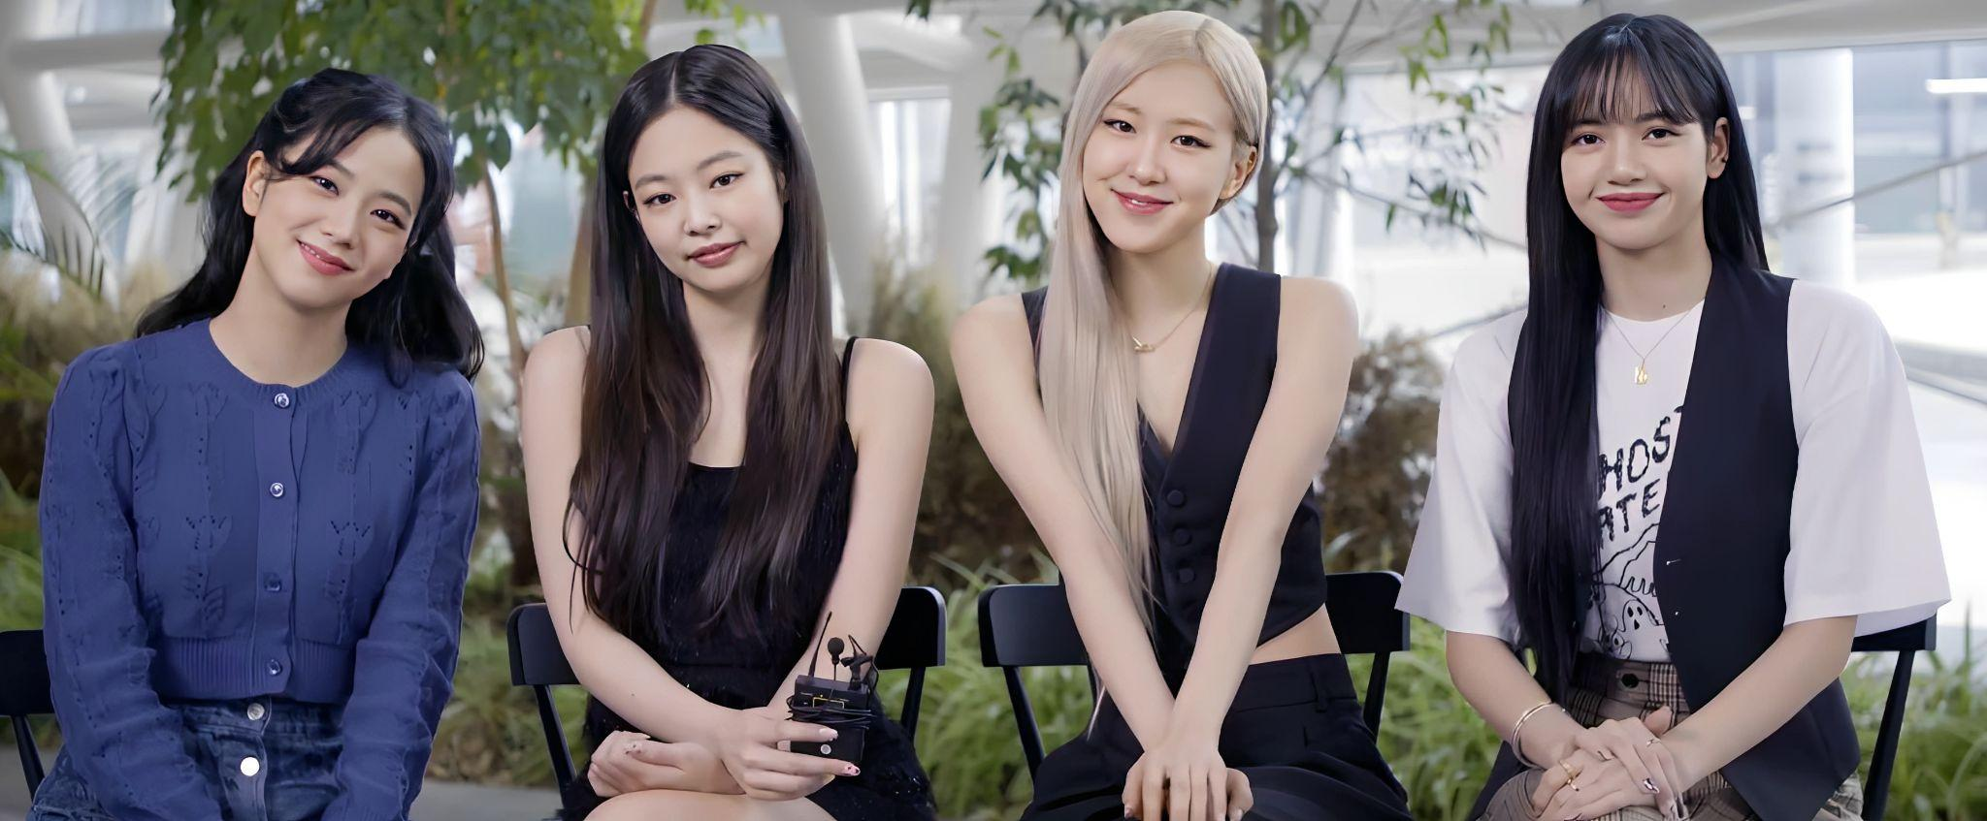
¿____________ ___ _____________?
Notes:
Black Pink, The students should know the specific names

Slide 20
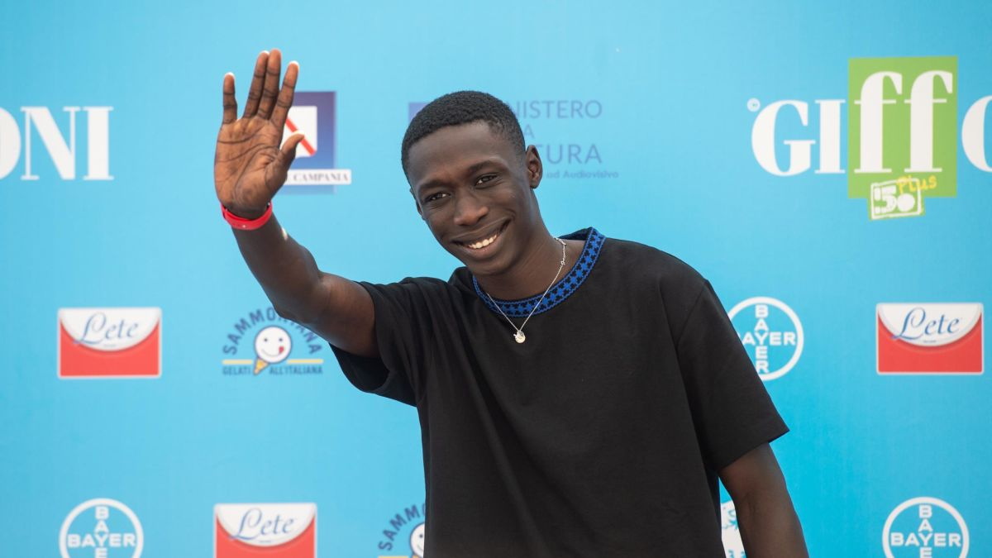
¿____________ ___ _____________?
Notes:
Khaby Lame

Slide 21
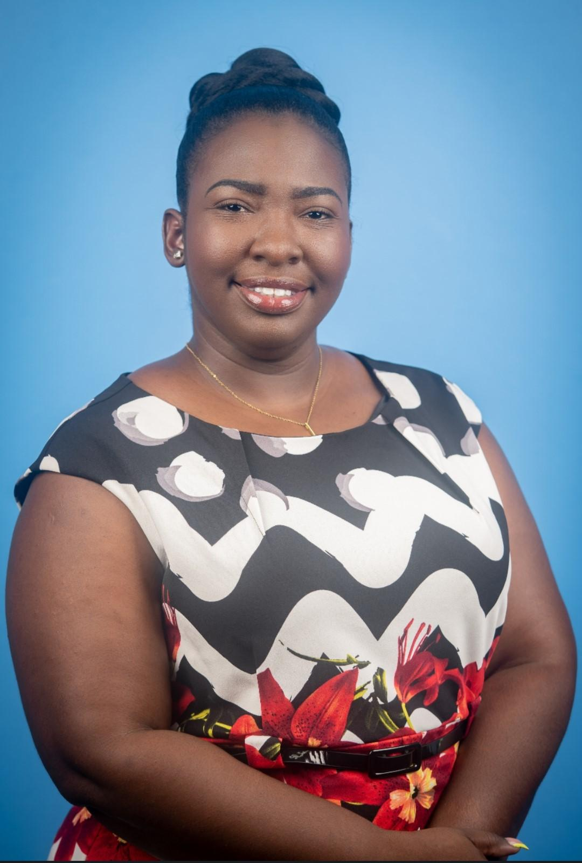
¿____________ ___ _____________?
Notes:
Ella es Sadé Smiths-Josephs

Slide 22
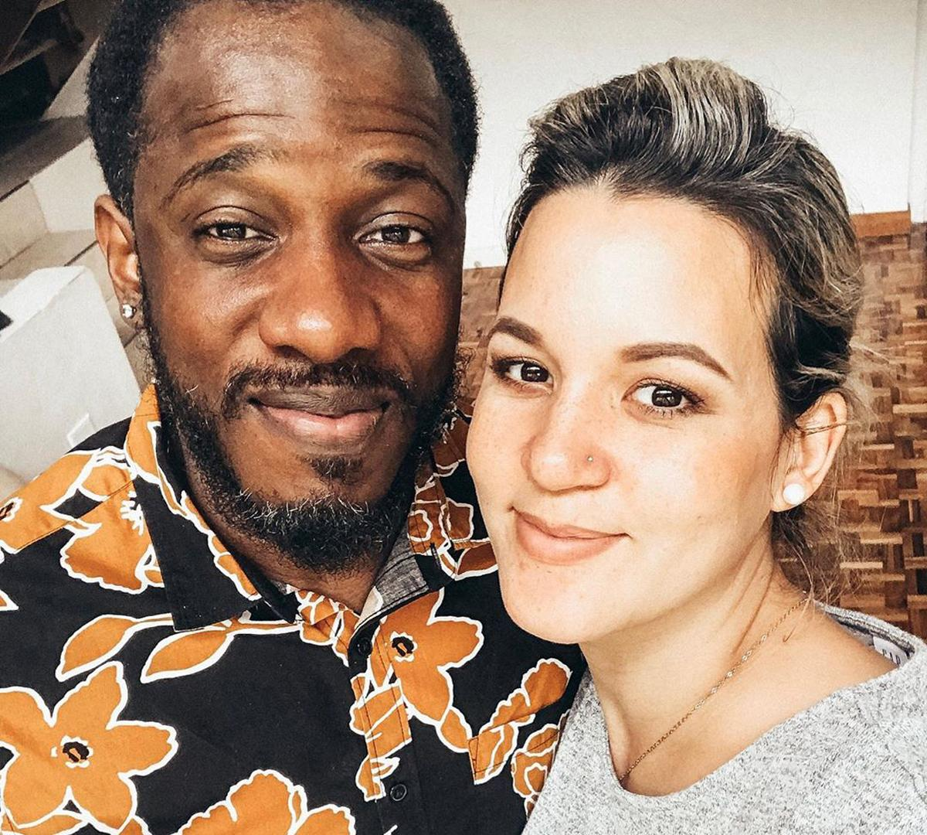
¿____________ ___ _____________?
Notes:
Ellos son Wayne and Tami Mitchell

Slide 23
Making a negative sentence
In spanish, to make a negative sentence, we place no directly before the verb.
Por ejemplo:
¿Eres Abigail?
No, no soy Abigail.
¿Es Juanita?
No, ella no es Juanita

Slide 24
In some the last few slides, you have seen the following expressions:
un hombre
una mujer
un chico
una chica
What do ‘un’ and ‘una’ mean?
Notes:
Elaboration: Students brainstorm on the meanings of the words”un” and “una”.

Slide 25
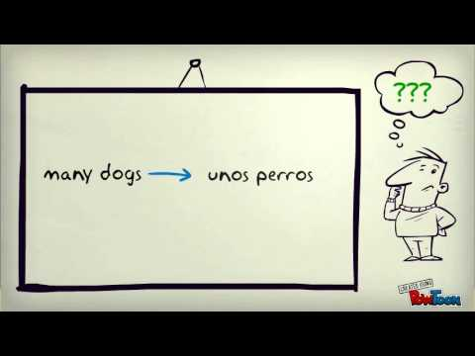
Indefinite Articles (un, una, unos, unas)
Notes:
Elaboration: Students watch this video (https://youtu.be/FD4MJmTEkeQ) and state:
the meaning of “un” and “una”
the meaning of “unos” and “unas”
the function of indefinite articles

Slide 26
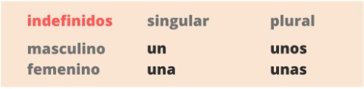
Activity: Indefinite Articles
Fill in the blanks with the appropriate indefinite articles:
____ tortuga
____ hermano
____ abuelo
____ primos
____ chicos
____ tías
____ hermana
____ mujeres
____ nietas
____ padres
Notes:
Elaboration: Students provide feedback through their answers to the above activity. Any lack of understanding is re-explained if necessary.

Slide 27
Upcoming Assignments
Grammar course work on the verb SER. (see slides)
Graded Oral Assignment
Graded Listening Assignment

Slide 28
Actividad Oral 🗣️
In groups of two, students are to ask each other,
¿Quién eres tú?
One student is to ask, and the other is to answer with their name and possibly a family connection.

Slide 29
3a CLASE
Match the subject pronouns to the correct forms of SER.
ellos/ellas
somos
ustedes
tú
soy
son
usted
él/ella
yo
nosotros
eres
es
Notes:
Engagement: Students match the subject pronouns to the forms of SER to review concept learnt in previous lesson.

Slide 30
👁️ Ojo 👁️
We use the verb form that corresponds with él or ella when talking about a singular person.
e.g. Él __ un hombre. → Will Smith ___ un hombre.
Ella __bonita. → Ariana ___ bonita.
We use the verb form that corresponds ellos/ellas when talking about several persons or several things.
e.g. Ellos ___ altos.→ Lebron James y Lizzo ____altos.
Ellas ____ bonitas. → Las abuelas ______ bonitas.
Notes:
Explanation: Teacher explains how to conjugate SER when there is no visible pronoun in a sentence.

Slide 31
👁️ Ojo 👁️
…y yo = Nosotros/as
We use the verb form of nosotros/as when you include yourself in a group of people as the subject of the sentence.
e.g. Gary y yo ______ altos.
Ustedes y yo ______ bonitas
Notes:
Elaboration: Teacher explains how to conjugate SER when the subject is the equivalent of “--- and I” (just another way of saying “we”.)
Explanation: Students practise conjugating SER with and without visible subject pronouns to work with. They will answer the questions:
What does “Gary y yo” mean?
By saying “y yo” who is included in the subject of the sentence?
Which subject pronoun could you substitute for “Gary y yo”?
To be graded.

Slide 32
Los pasos para conjugar
Identify the subject of the sentence:
Señora Morgan Francis ______ muy linda.
Ask yourself two questions:
Is the subject singular or plural?
Is the subject a male or female?
Think of the pronoun that would replace that subject
Señora Morgan Francis - She = Ella
Write the correct form of the verb!

Slide 33

Complete the following sentences with the correct form of the verb SER:
Ciara___ la hija de Manuel.
Miguel no ___ un hombre.
Yo ___ directora .
Nosotros y ellos ___ amigos.
Tú y yo ___ hermanas.
Mi mama y su hermana ___ las primas de Juan.
Mis padres ___ bajos.
Sabrina y José ___ esposos.
Las chicas y yo ___ inteligentes.
Tu familia ___ grande.
Using a highlighter or crayon, identify the subject of the sentence
Notes:
Explanation: Students practise conjugating SER with and without visible subject pronouns to work with. Numbers 5 and 9 were not explained, so students will be required to explain their choices for those two items. They will answer the questions:
What does “Cara y yo” mean?
By saying “y yo” who is included in the subject of the sentence?
Which subject pronoun could you substitute for “Cara y yo”?
To be graded.

Slide 34

Identify the subject by circling it and complete the following sentences with the correct form of the verb SER:
Ciara___ la hija de Manuel.
Miguel no ___ un hombre.
Yo ___ directora .
Nosotros y ellos ___ amigos.
Tú y yo ___ hermanas.
Mi mama y su hermana ___ las primas de Juan.
Mis padres ___ bajos.
Sabrina y José ___ esposos.
Las chicas y yo ___ inteligentes.
Tu familia ___ grande.
20 marks
Notes:
Explanation: Students practise conjugating SER with and without visible subject pronouns to work with. Numbers 5 and 9 were not explained, so students will be required to explain their choices for those two items. They will answer the questions:
What does “Cara y yo” mean?
By saying “y yo” who is included in the subject of the sentence?
Which subject pronoun could you substitute for “Cara y yo”?
To be graded.

